Slide 1
Predict the severity of car accident
Karla Itzel vega ortega

Slide 2
Description
The first step in this Capstone Project is to determine the objectives of the activity, which are the following:
Reduce the amount of car accidents in target zones.
Analyze how weather conditions can affect / increase road accidents
Warm people about areas where car accidents are higher
Probe that depending on the junction the probabilities to suffer a misfortune will vary
Show the reader an overall analysis of car accidents and how to avoid them

Slide 3
Data acquisition and cleaning
The information was taken from the Excel of the course Applied Data Science Capstone, with the following characteristics:
194,673 total information rows
38 attributes, this exercise will only take into consideration 8 columns:
LOCATION, PERSONCOUNT, VEHCOUNT, JUNCTIONTYPE, WEATHER, ROADCOND, LIGHTCOND, SPEEDING
Due to location is a main characteristic and there are rows with no address the universe reduce to 191,997
This data will help us to achieve the main objective which is to reduce the amount of car accidents

Slide 4


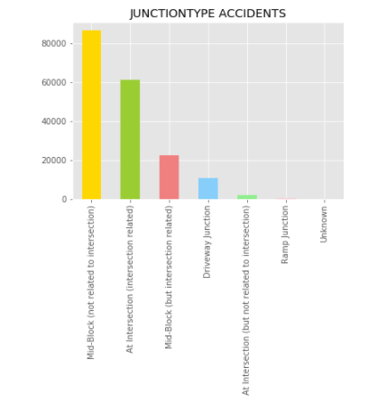
Description of the data
It is possible to see that the number of accidents increased when the JunctionType is Mid-Block (not related to the intersection)
The Data “Unknown” is not representative so we might say that the distribution could be accepted
In Ramp Junctions is where there are least accidents

Slide 5
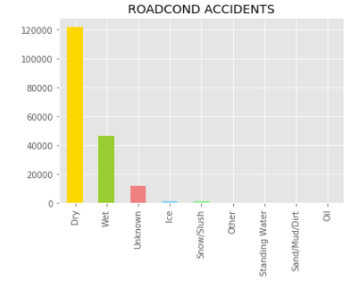
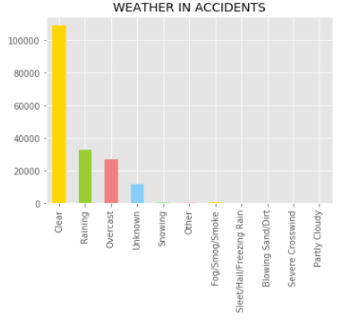
As seen, accidents are likely to happen when the climate conditions ARE CLEAR.
THEY OCCUR WHEN WEATHER IS REAINING AND OVERCAST BUT IT IS NOT SIGNIFICANT
Roadconditions accidents happen when it is dry and wet.
There is also data with “unknown” but is not significant

Slide 6
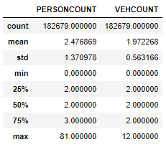
What about the people and cars involved
In the left data it is possible to see that the people involved in an accident are 2.4 average and the cars are 1.9.
This data show us that when accidents occur not only one car is affected nor one person.

Slide 7
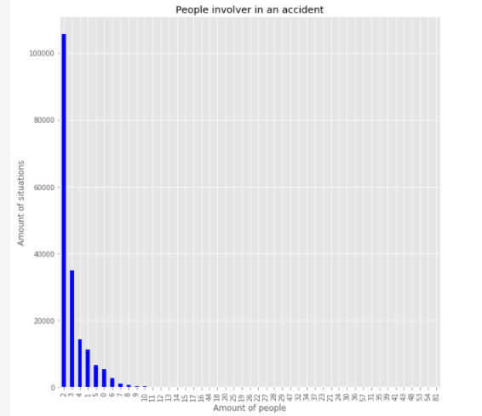
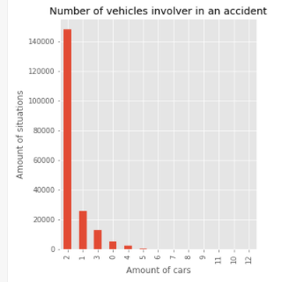

Slide 8
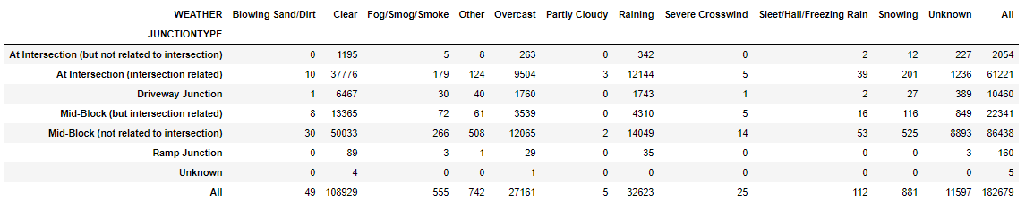
In this chart I wanted to show the relations between Weather and JunctionType and when accidents are more likely to happen.
We can see that there are higher chances to suffer a misfortune if the following conditions are happening
The weather is clear and the Junctiontype is Mid-Block
The weather is clear and the Junctiontype is At Intersection
The weather is raining and the Junctiontype is Mid-Block

Slide 9
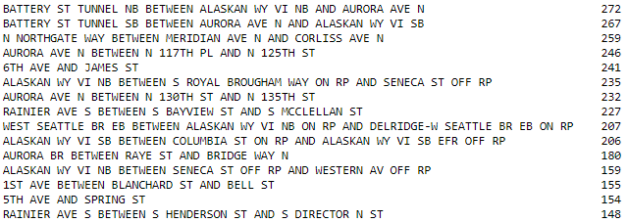
location
The following list show us the first 15 places where more accidents tend to occur.

Slide 10
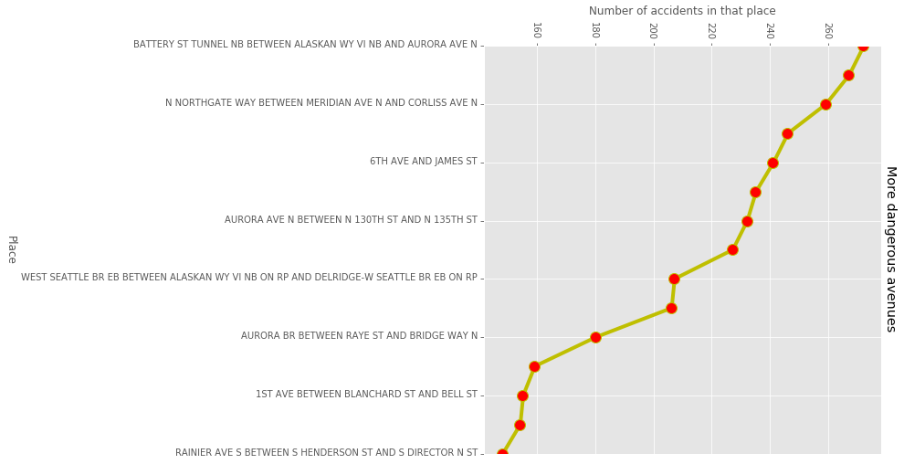

Slide 11
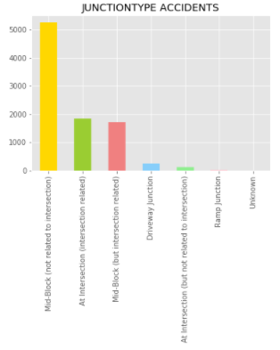
Analysis when speed was the cause of the accident
The junctiontype, the weather and the lightconditions do not change even when the speed does. In other words, even if we go slow, if the same conditions happen at the same time, an accident could be presented.

Slide 12
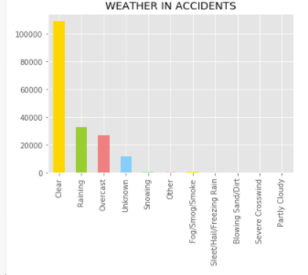
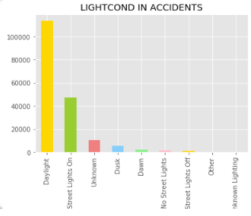

Slide 13
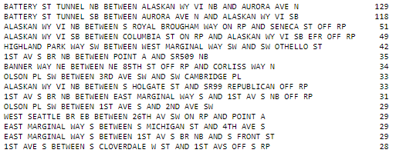
What about the location when the speed is a factor
Surprisingly when the speed is a factor in the accident the locations chance. It is than when the speed is higher there are certain places where is more probable to suffer a misfortune. It could be due to curves in the roadway
The list is the following

Slide 14
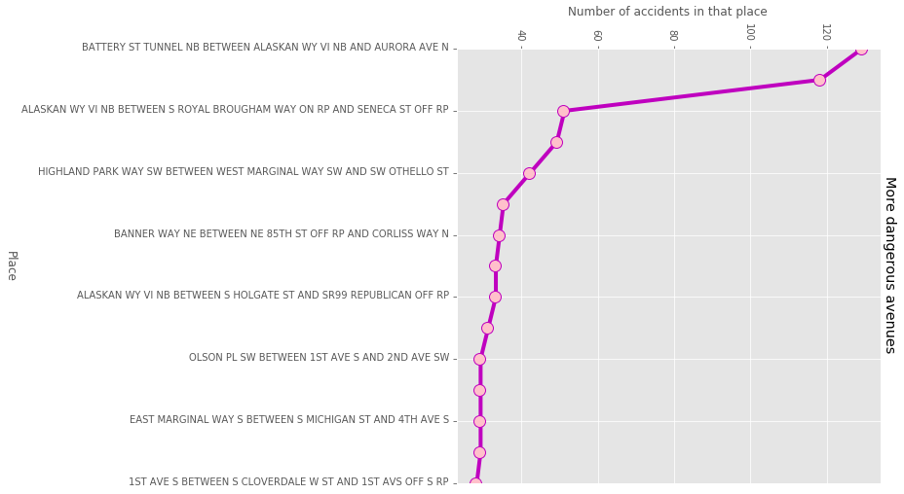
What about the location when the speed is a factor

Slide 15
Conclusion
The objective of this case study was to analyze where accident are more likely to occur.
The results are the following, overall, people will have more chances to suffer a car accident if…
They are driving trough the first 15 – 50 locations shown in the Jupyter Notebook (The first 15 are show in the slide 8)
They are driving when the weather is clear, the Junctiontype is Mid-Block and ROADCOND is Dry
The people involver is 2.5 per accident and 1.9 vehicles
Finally there is almost no difference in the weather conditions, Junctiontypes, etc when the speed is a factor. Only the locations, it could be due to the amount of curves in a roadway

